Slide 1

Hospitality Revenue Analysis
ATLIQ GRANDS
By L. Smitha Rai

Slide 2
Presentation Outline
Objective
Dataset Overview
AtliQ Grands Analysis
Overall Analysis
Weekly Analysis
Key findings
Recommendation

Slide 3
Objective
AtliQ Grands owns multiple five-star hotels across India. They have been in the hospitality industry for the past 20 years.
AtliQ Grands are losing its market share and revenue in the luxury/business hotels category.
As a strategic move, the managing director of AtliQ Grands wanted to incorporate “Business and Data Intelligence” to regain their market share and revenue.

Slide 4
Dataset Overview
Dimension Tables
Fact Tables
Dim_rooms
room_class
room_id
Dim_hotels
category
city
property_id
property_name
Dim_date
Date
day_type
mmm yy
month
Fact_bookings
booking_date
booking_id
booking_platform
booking_status
check_in_date
check_out_date
no_guests
property_id
ratings_given
revenue_generated
revenue_realized
room_category
Fact_aggregated_bookings
capacity
check_in_date
property_id
room_category
successful_bookings

Slide 5
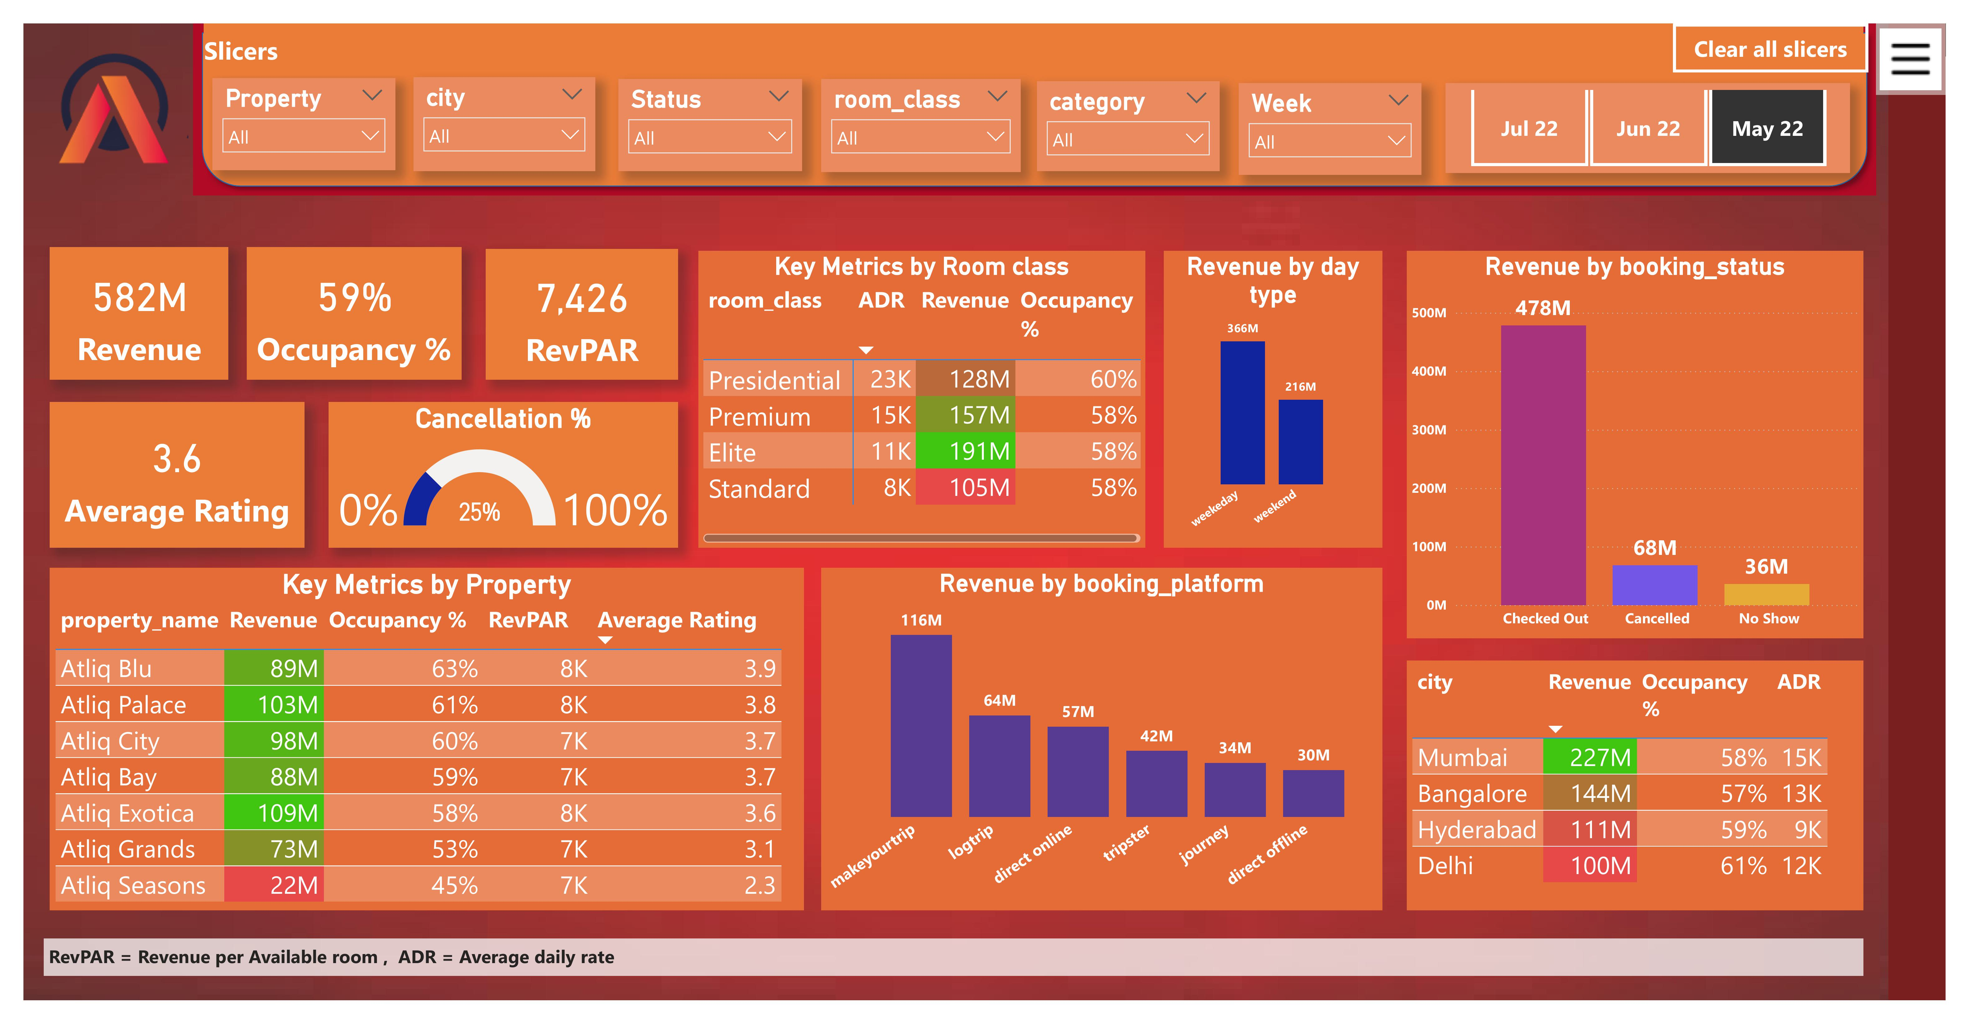

Slide 6
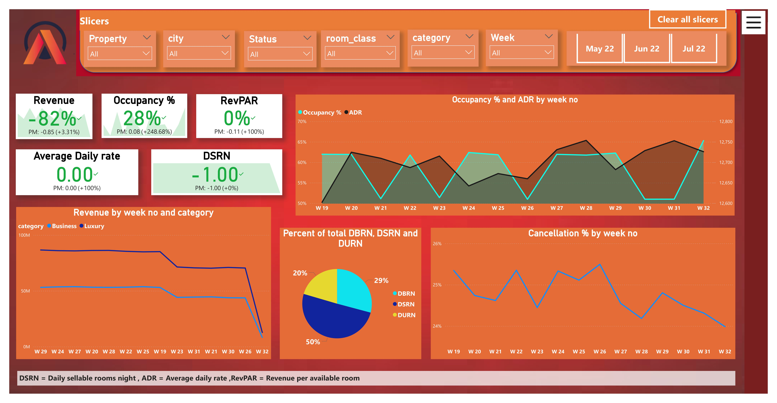

Slide 7
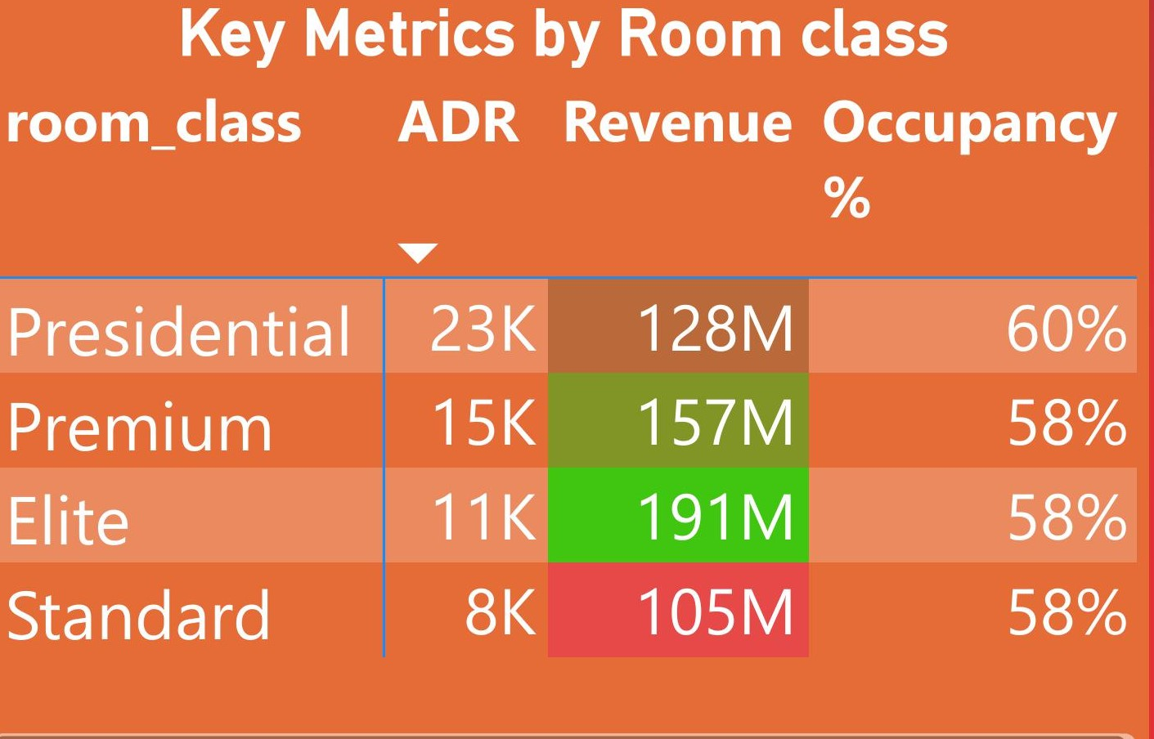
Key Findings
Standard rooms contribute 18% to total revenue, while the elite rooms contribute 32% to total revenue.
High discounts on rooms have reduced revenue.
Occupancy rates remain stable despite discounts.

Slide 8
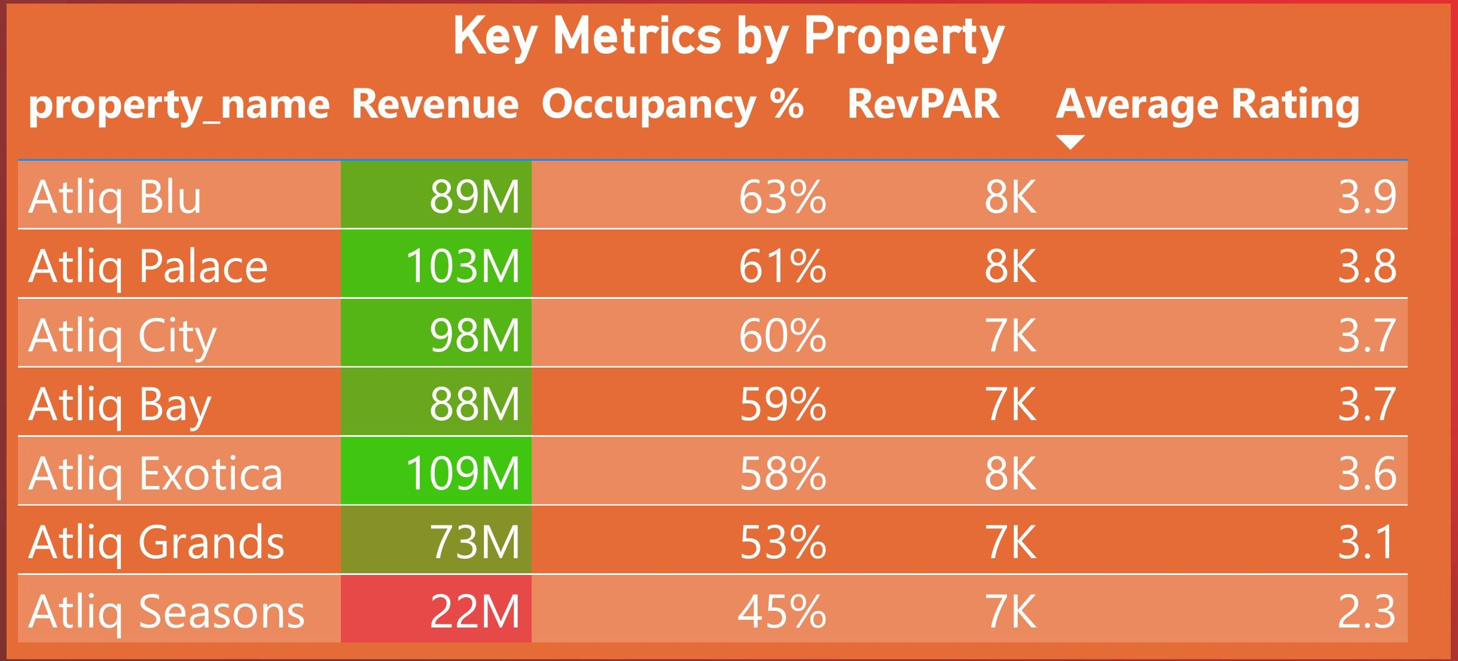
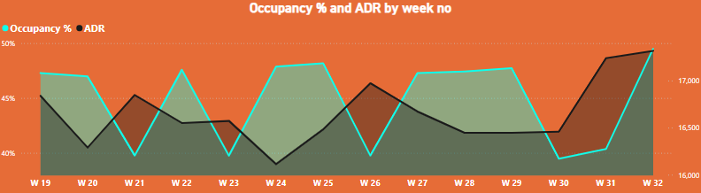
Although AtliQ Seasons has the lowest revenue, with its presence limited to a single city.
Gradual increase in occupancy rate over time signals growth potential.

Slide 9
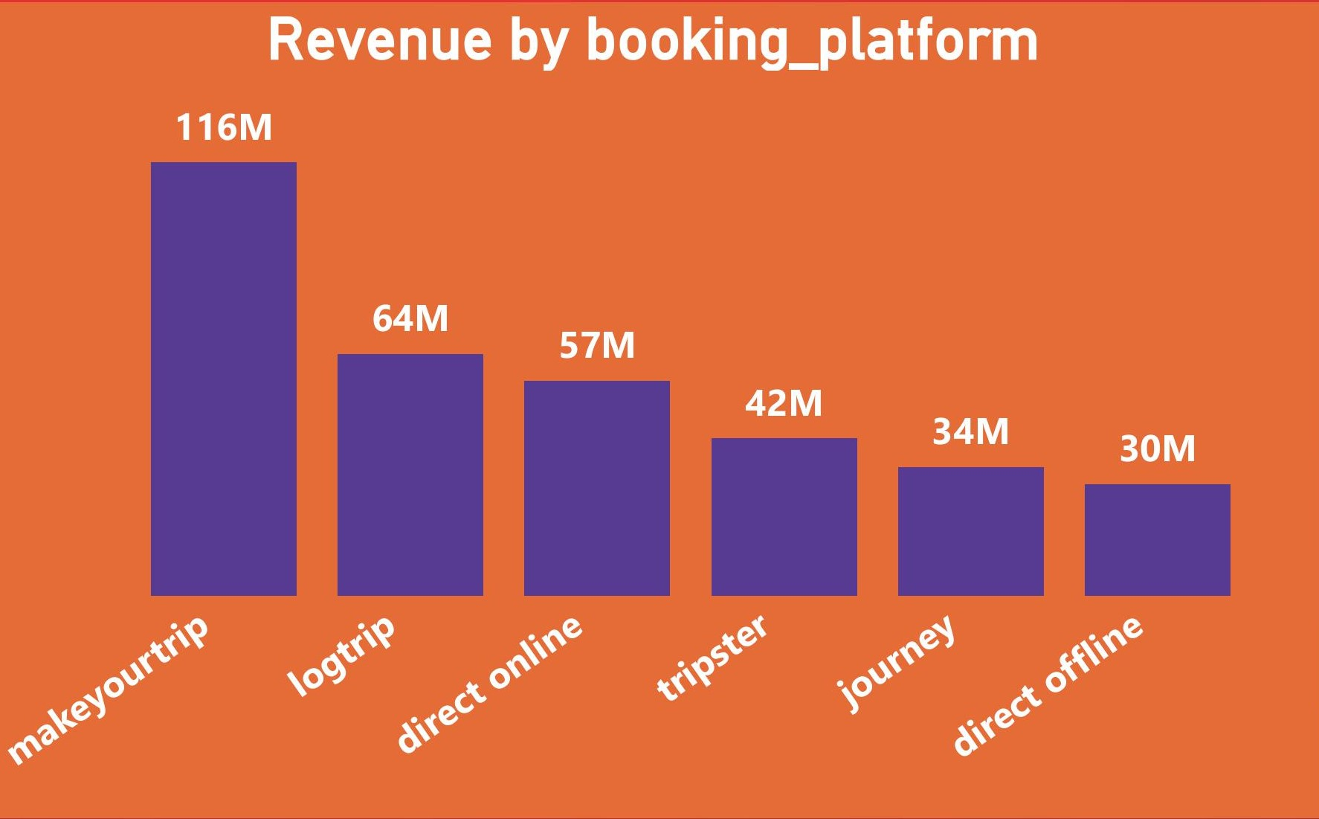
MakeYourTrip generates the highest revenue, accounting for 34% of successful bookings.
LogTrip (direct online) follows as the second-highest contributor.
Direct offline bookings contribute only 8% to revenue.

Slide 10
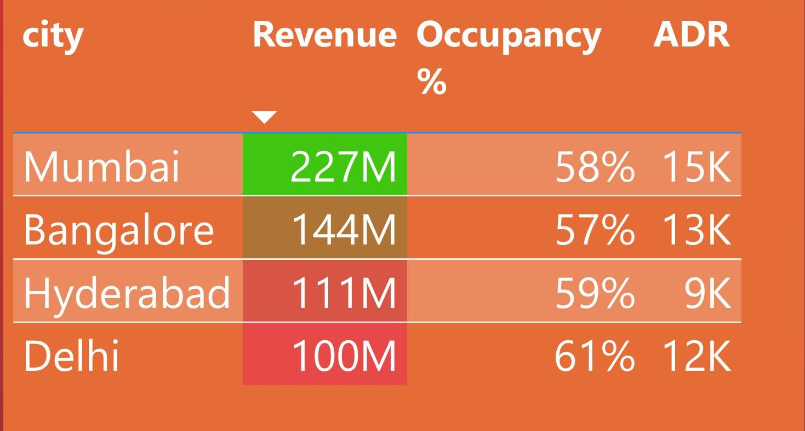
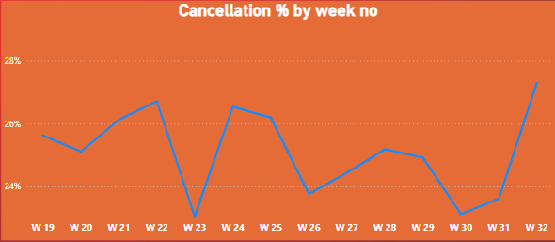
Mumbai: High revenue, but the growth from the last month is only 2.57%.
Delhi: Lower overall revenue, but the growth is 3.67%, indicating a stronger improvement rate despite a smaller starting point.

Slide 11
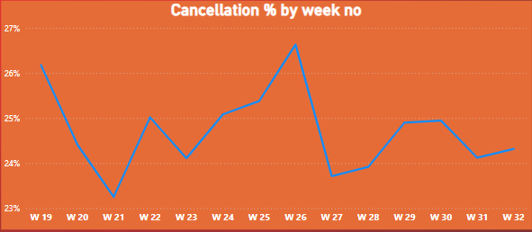
DELHI
Delhi has a higher cancellation rate compared to Mumbai. While cancellations can negatively impact revenue, Delhi's revenue growth despite this suggests the market there is still growing faster.
MUMBAI

Slide 12
Recommendations
Optimize ADR based on demand trends.
Investigate the revenue the reasons for low revenue from direct offline bookings.
Strength partnerships with high performing streams like makeyourtrip by offering seasonal and strategic discounts to boost revenue further.
By capitalizing on Delhi’s growth, the market share could increase as demand continues to rise.
With targeted efforts to improve cancellations (e.g., better customer service, improved booking policies), even more revenue can be captured.

